Slide 1
BANK LOAN ANALYSIS

Slide 2
GROUP 2
MEMBERS:
MS. BANDANA HAZARIKA
MS. DHANASHRI NAMDEV GURAV
MR. ARIF ABDUL MULANI
MR. RUPESH RAMESHWAR AGADE
MR. ABHISEK BEHERA
MR. SAYAN MUKHERJEE

Slide 3
INTRODUCTION
In this project, we delve into the analysis of a comprehensive Bank Loan datasets. This datasets provide a wealth of information regarding loan portfolios, borrower demographics, repayment histories, and more. Our analysis aims to uncover valuable insights that can inform strategic decision-making within the financial sector. We go beyond mere numbers, exploring the intricacies of loan origination, repayment behavior, and risk assessment.

Slide 4
PROJECT AIM
Our project aims to analyze the datasets to gain comprehensive insights into loan portfolio performance and borrower demographics.
We seek to optimize lending strategies by leveraging data from the dataset, enabling better risk assessment and decision-making.
Our goal is to enhance operational efficiency by integrating and analyzing loan origination, repayment, and customer data from the data set
Through advanced analytics, we aim to identify trends, patterns, and correlations that influence loan default rates and repayment behavior.
Our project endeavors to harness the datasets to drive informed actions, improve portfolio quality, and maximize returns on investment.

Slide 5




Approach
Groups , bins, measures, filters
Power query
EDA
Data Pre processing
Data Analysis
Classification
Get data
Statistical analysis
cleaning
Transforming
Data validation
Data visualization
Dashboards
KPI’s
Power BI
Charts, cards, conditional formatting

Slide 6



Tools and visualizations used in analysis
Calculated
Fields
Parameters
Conditional formatting
Slicers
Visualization
Power BI
Measures
Dax
Parameters
Conditional formatting
Slicers
Actions
RDBMS
Fetching
Joins
Triggers
Def Functions
Functions
Filters
Pivot Table
Conditional formatting
Slicers

Slide 7
KPI’s
Year & Grade Wise Repayment Rate
Top 10 Member Wise Loan to Value Ratio
Top 5 Purpose Wise Agg Customer Satisfaction
QTR Wise Customer Risk Assessment
Loan Wise Max Loan Origination Cost

Slide 8
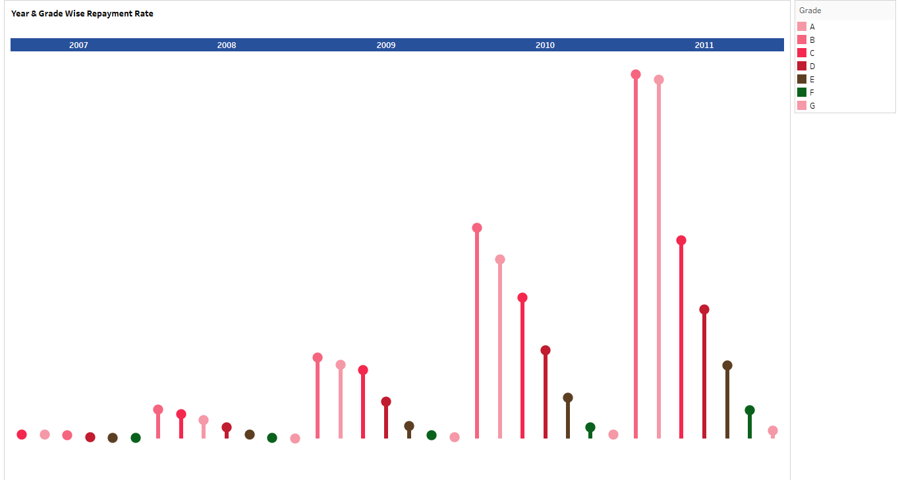
Year & Grade Wise Repayment Rate
In 2011, Grade B has the highest Repayment Rate i.e., 13.65.

Slide 9
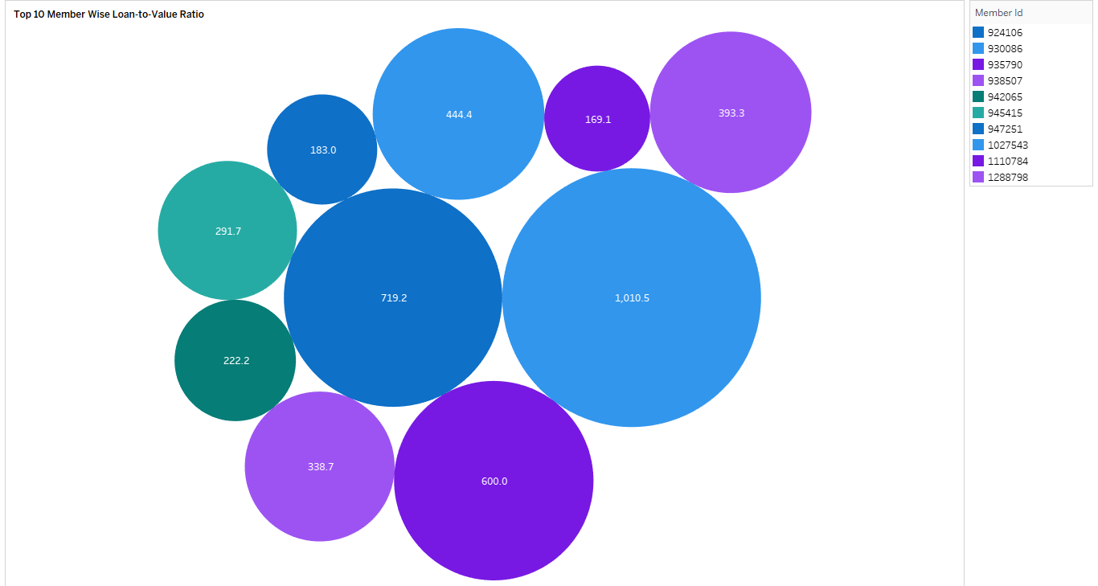
Top 10 Member Wise Loan to Value Ratio
Member with Member_id 930086 has the highest LTV ratio of 1010.5

Slide 10
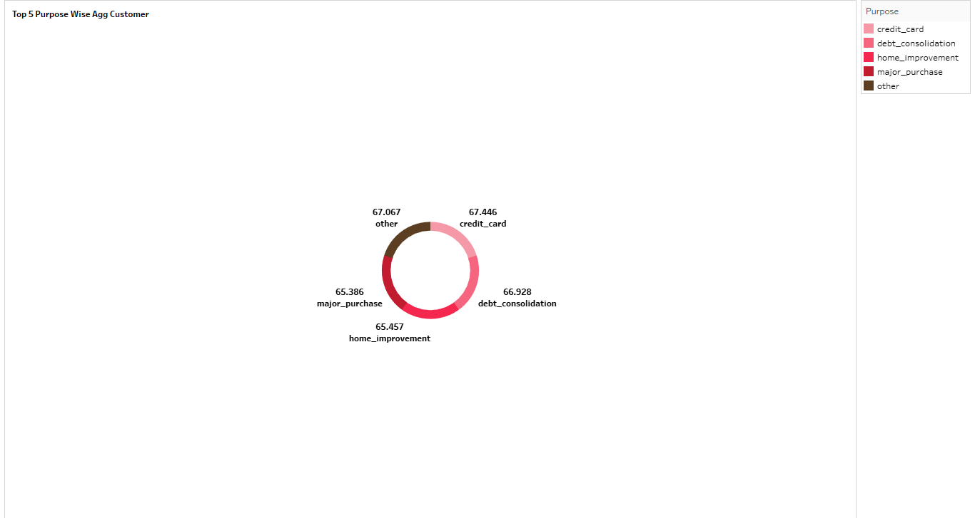
Top 5 Purpose Wise Agg Customer Satisfaction
It depicts that customers with loan purpose of “Credit Card” have been granted most loans.

Slide 11
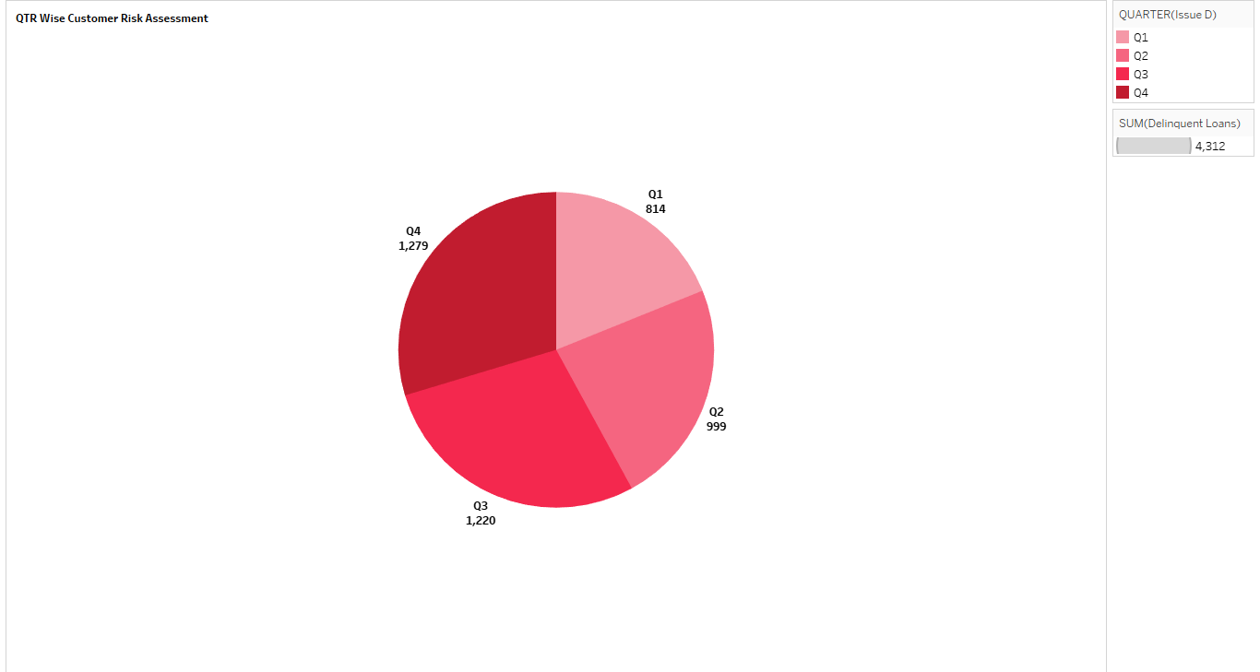
QTR Wise Customer Risk Assessment
Highest loan delinquency rate has been in Q4 throughout, which is 1279

Slide 12
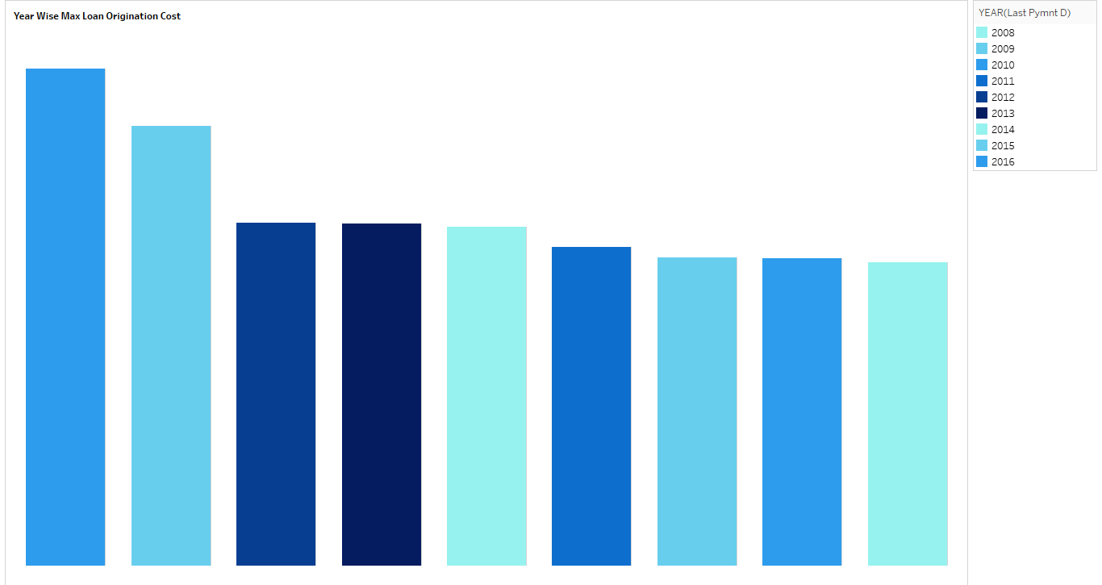
Loan Wise Max Loan Origination Cost
Maximum Loan Origination cost has been in the year 2016.

Slide 13
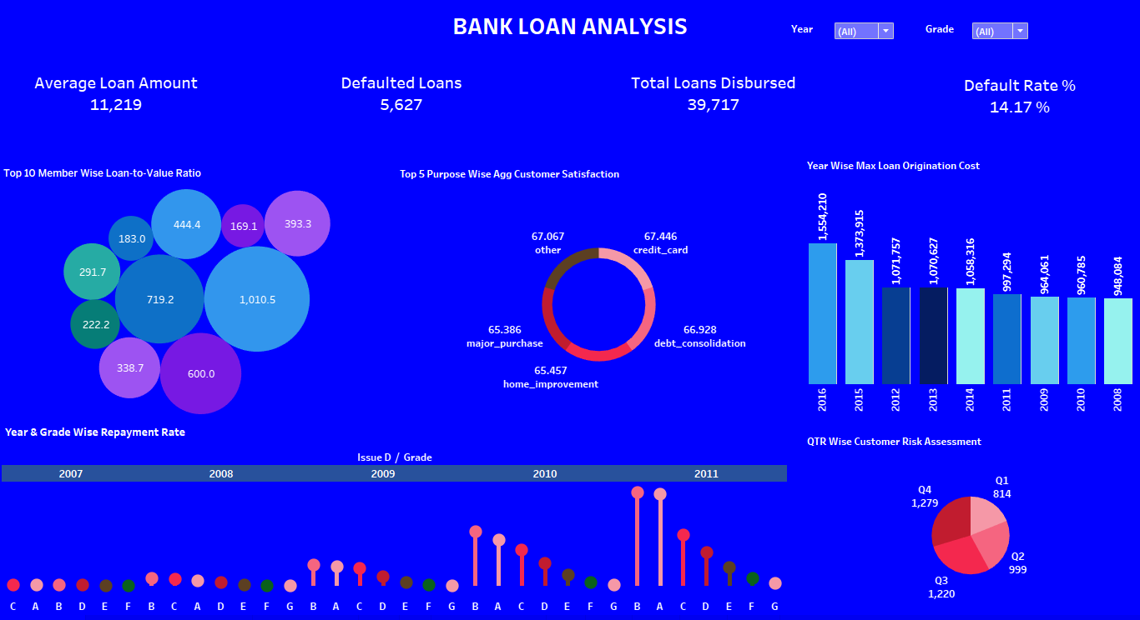

Slide 14
Insights
By visualizing the Bank Loan datasets we have observed different insights:
Impact of Delinquency History on Loan Terms:
Borrowers with a delinquency history of more than 2 years receive loans with higher interest rates, reflecting risk assessment practices.
Impact of Revolving Credit on Loan Approvals:
Borrowers with high revolving credit balances are 30% less likely to be approved for loans, indicating creditworthiness considerations.
Loan Approval Rates by Grade:
Grade A loans have highest approval rate, while Grade D loans have lowest approval rate, indicating varying risk assessments.

Slide 15
Insights
Seasonal Variation in Loan Demand:
Loan applications peak during the summer months, suggesting increased demand for vacation expenses and home renovations.
Effectiveness of Debt Recovery Efforts:
Debt recovery efforts have led to a 30% increase in recovered funds in the last quarter, showcasing improved collection strategies.

Slide 16
Recommendations
Actionable strategies :
Implementation of advanced risk assessment models leveraging borrower demographics and repayment history to identify high-risk applicants.
Launching of targeted financial literacy programs to educate borrowers on responsible borrowing practices and debt management techniques.
Optimization of loan approval processes by leveraging automation and digital technologies to reduce processing times and enhance efficiency.
Recommend diversifying the loan portfolio by expanding into sectors with lower default rates, such as education or healthcare, to mitigate concentration risk.
Implementation of proactive delinquency management strategies, including early intervention and personalized repayment plans, to reduce default rates
Establishment of a robust monitoring system to track loan performance metrics in real-time and conduct regular analysis to identify emerging trends and risks.

Slide 17
CONCLUSION
In closing, our analysis of Bank Loan datasets have provided invaluable insights into our loan portfolio. By implementing actionable recommendations, we can enhance loan quality, mitigate risks, and drive sustainable growth. Together, let's embrace innovation and collaboration as we navigate the path to financial excellence. Thank you for your dedication and commitment to our shared success.

Slide 18


